Slide 1
Effects of voltage imbalance on 3-phase induction motors
Design team 3

Slide 2
Presentation content
Introduction
3-Phase System Explanation
Common Causes of Imbalance
Motor operation basics
Effects:
  Electrical Power Consumption Increase
  Thermal Degradation of Isolation
  Shorting of Windings
  Negative Sequence Imbalance
  Costs Incurred
Conclusion
Questions

Slide 3
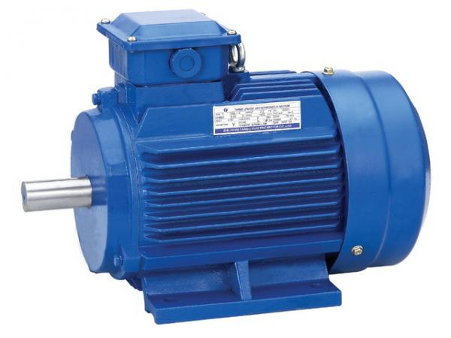
introduction
Voltage Imbalance is a very common in a 3-phase system with unequal loads. This Imbalance leads to many issues, especially with loads that are attached to all three phases. One such load is a 3-phase induction motor. Many factories utilize these lower-cost ruggedly designed machines to power different parts of their assembly lines.

Slide 4
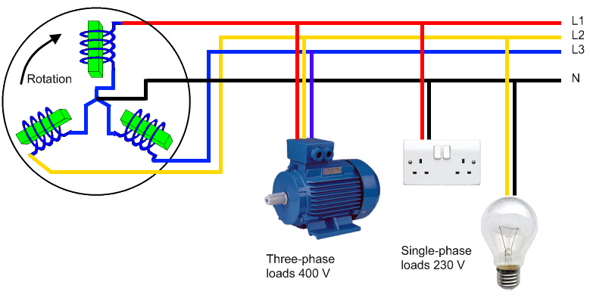
Introduction Cont’d
This topic is important to team 3 because we are designing a 3-phase power monitor to detect voltage imbalances and send notifications before the issues presented in this presentation arise.

Slide 5
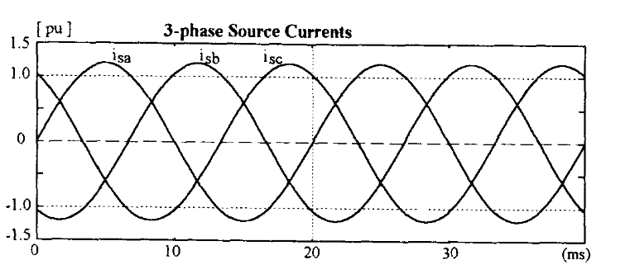
3-phase system
In short, a three phase system is an electrical power design that can transfer three times the power by adding one more wire than our original single phase designs. By Kirov's Current law, the current that passes through an element must come back to the source. With this design, two wires would be needed. If we apply three sources to three wires but offset them by 120 degrees, the net current would result to zero. This can be seen in figure 1 below. Using this, we would no longer need a wire for the return current and by adding 1 more wire than the two-wire design, three times the power can be transmitted.

Slide 6
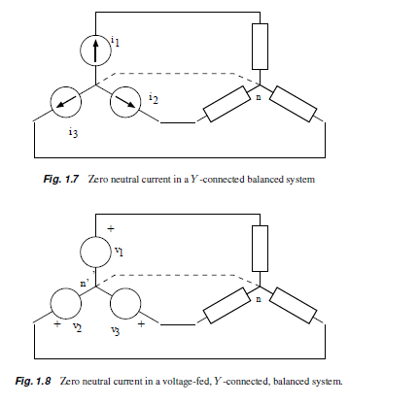
3-phase system cont’d
This is the basic concept of operation for the electrical grid used by utility companies and large factories today

Slide 7
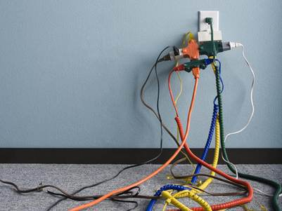

Common causes of voltage imbalance
Voltage imbalance can be caused by unbalanced loads while severe short-term imbalance can be caused by power system faults.

Slide 8
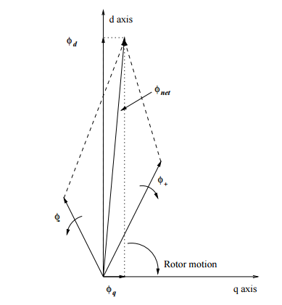
Induction motor basics
When a time varying voltage is applied to a winding, a flux is created
When a time varying flux is applied across rotor bars, a voltage is induced. This voltage in turn produces a current when the bars are shorted at the ends.
This reaction produces a flux 90 degrees in reference to the original flux applied these actions cause the rotor to turn.

Slide 9
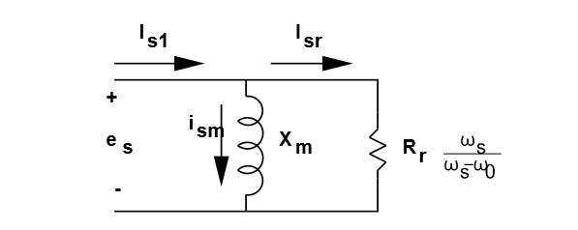
Induction motors cont’d
The rotor can be one of two major types:
  It is wound in a fashion similar to that of the stator with the terminals led to slip rings on the shaft.
  It is made with shorted bars.
3 phase motors are made of a combination of three stator windings. This allows a stronger and more consistant flux to be abllied to the rotor winding. This inturn produces more torgue out of the motor.

Slide 10
electrical power
Unbalanced voltages at motor terminals cause current unbalance ranging from 6-10 times the percent of voltage unbalance
  Voltage unbalance of 1% correlates to 6%-10% current unbalance
  Over current results in excessive heat, shortening the motor life
Efficiency of the motor is reduced
  Power output remains the same while electrical power input increases due to the increase in current as well as increased resistance due to heating
  The increase in resistance and current stack to contribute to an exponential increase in the motor heating

Slide 11
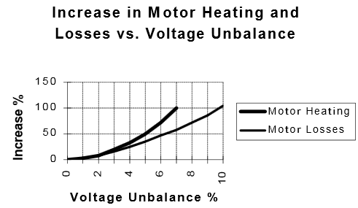
Cont’d
Winding losses can be calculated using I²R
  Current unbalance of 10% will increase winding losses by 21%

Slide 12
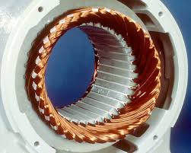
Thermal degradation of insulation
Excessive power cause overheating of insulation
Material brakes down
Winding short together

Slide 13
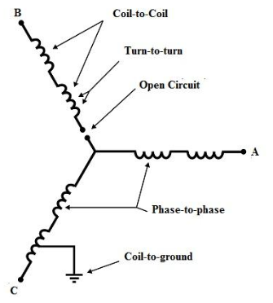
Winding short circuits
Excessive heat leads to winding insulation degradation which will cause windings to short together
Shorted turns in stator windings often do not affect the normal operation in the early stage
Types of shorts
  Turn-to-turn of same phase
  Coil-to-coil of same phase
  Phase-to-phase
  Coil-to-ground

Slide 14
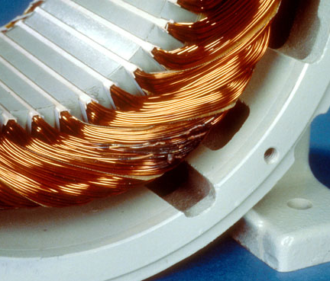
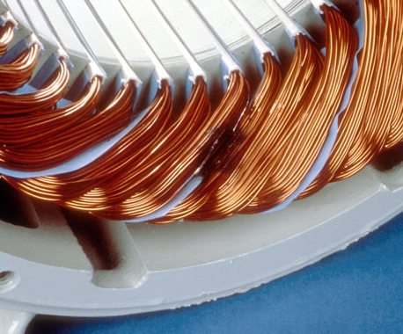
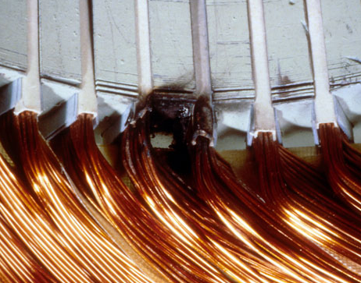
Type of shorts
Turn-to-turn of same phase
  Motor might continue to operate, even though short-circuit current will flow, causing more overheating, ultimately leading to complete failure
Coil-to-coil of same phase
  Motor might continue to operate, even though short-circuit current will flow, causing more overheating, ultimately leading to complete failure
Phase-to-phase
  Detrimental, causes instantaneous motor shutdown
Coil-to-ground
  Detrimental, causes instantaneous motor shutdown
Turn-to-turn
Phase-to-phase
Coil-to-ground

Slide 15
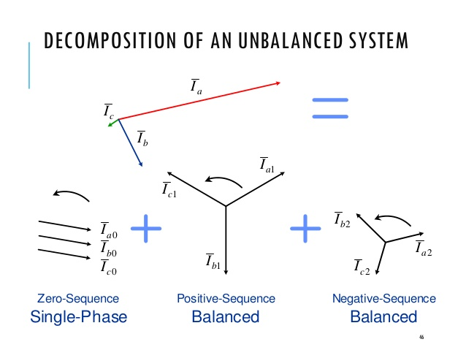
Negative sequence voltage
The adverse effects of unbalanced voltages on induction motors stem from the fact that the unbalanced voltage breaks down into two opposing components that can de described using a method of symmetrical components.
Through the use of symmetrical components, we can describe an unbalanced three-phase system of voltage or current phasors using three balanced systems of phasors termed positive, negative and zero sequence.

Slide 16
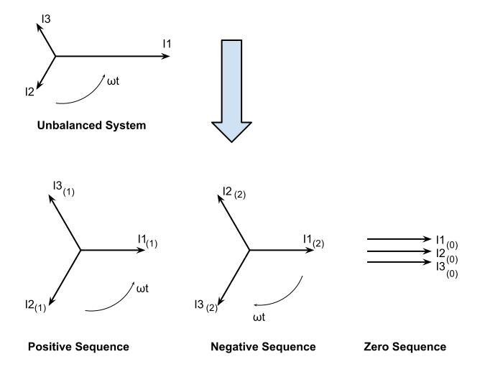
Negative sequence voltage CONT’D
In the case of machines, motors are typically connected delta or ungrounded wye. Therefore, there would be no path to neutral for the zero components to flow. Which would result in the zero sequence components resulting to zero. Leaving us with just the positive and negative sequence.

Slide 17
Negative sequence voltage CONT’D
The positive sequence set consists of the balanced three-phase currents and line-to-neutral voltage supplied by the system. They are all equal in magnitude and phase, rotating at the system frequency with a phase sequence of normally a, b, c.

Slide 18
Negative sequence voltage CONT’D
The negative sequence set consists of the balanced three-phase currents and line-to-neutral voltage supplied by the system. They are all equal in magnitude and phase, but with opposite phase rotation.

Slide 19
What does this mean for the system?
Reduced net torque and speed
  Positive sequence voltage produces the desired positive torque, but the negative sequence voltage goes against the rotation of the rotor producing an unwanted negative torque.

Slide 20
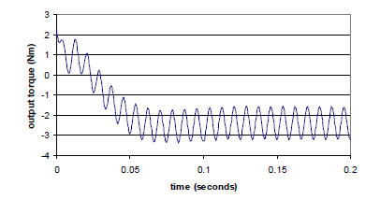

What does this mean for the system?
Possibility of torque pulsations and motor noise
  Torque pulsations sometimes result as an effect of the unbalanced voltages on the output torque of the machine. The size of the torque pulsation is affected by the size of the negative-sequence current.
  Torque pulsations increase fatigue load on mechanical components and increase motor noise

Slide 21
What does this mean for the system?
Increased machine losses and temperatures
  the negative voltage sequence component will generate large negative sequence currents due to the low negative sequence impedance. This large negative current increases the machine copper losses and temperatures.

Slide 22
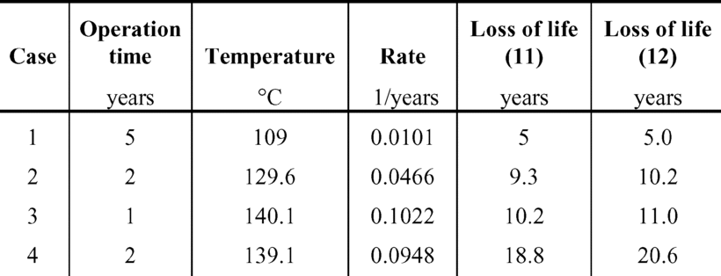
Costs of voltage imbalance
Measured rotor currents in induction motors operating with unbalanced voltages show that a 5% unbalance decreases the motor life to 30%

Slide 23
Cost cont’d
Cage rotor induction machines account for over 80% of energy conversion in industrial and commercial sectors.
The cost of a 200 HP induction motor is anywhere between $15,000 and $20,000.
Industry consumed 534 Million kW in 2015.
Cost of running induction motors in industry - $ 555,000,000.00

Slide 24
summary
Three-phase systems deliver three times more power than a single-phase system.
Unbalanced voltages lead to unbalanced currents 6 to 10 times greater.
This increase in current causes the induction motor to heat up.
The increase in heat leads to the thermal degradation of insulation.
Importance to our project
  Troubleshooting power quality problems requires accurate measurements and our project measures all three voltages, currents, power factor, and power. Giving a time stamp to any voltage transients so that proper diagnostics can be run.

Slide 25
QUESTIONS?

